Slide 1
Large Language Models for Generative AI
Dr. Monali Mavani

Slide 2

Large Language Models for Generative AI
Disclaimer and Acknowledgement
The content for these slides has been obtained from books and various other source on the Internet
I here by acknowledge all the contributors for their material and inputs.
I have provided source information wherever necessary
I have added and modified the content to suit the requirements of the course
Many slides are adopted from course notes of Zhou, S. (2026). Transformers in Practice. DeepLearning.AI

Slide 3
LLM Inference Fundamentals
Autoregressive Response generation
Decoding strategies and Sampling
Greedy, Top-K, Top P, temperature, Beam search

Slide 4


Autoregressive Response generation
LLM
Fix this code for me…
There’s a missing…

Slide 5
Response generation
Autoregressive Generation
LLM
Fix this code for me…
There ’s a miss ing …

Slide 6
Autoregressive generation
LLM
Fix this code for me…
There

Slide 7
Autoregressive generation
LLM
Fix this code for me…
There
There

Slide 8
Autoregressive generation
LLM
Fix this code for me…
’s
There
New tokens depend on past tokens

Slide 9
Autoregressive generation
LLM
Fix this code for me…
’s
There ’s
New tokens depend on past tokens

Slide 10
Step 1: Input Tokens
1: Input Tokens
Fix this for me:
def greet(name)
return "Hello, " + name
SyntaxError: expected ':'

Slide 11

Step 1: Input Tokens
1: Input Tokens

Slide 12
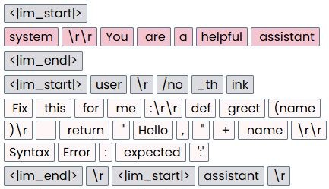
Step 1: Input Tokens
1: Input Tokens
prompt is being represented as structured conversation text, not just raw natural language.
system: system instruction, “You are a helpful assistant.”
user: user message with the code/debugging request.
assistant: start of the model’s answer region.

Slide 13
Step 1: Input Tokens
system prompt describes what the model should act and behave like
1: Input Tokens
System prompt

Slide 14
Step 1: Input Tokens
1: Input Tokens

Slide 15
Step 1: Input Tokens
1: Input Tokens
Fix this for me:
def greet(name)
return "Hello, " + name
SyntaxError: expected ':'

Slide 16
Step 1: Input Tokens
1: Input Tokens

Slide 17
Chat prompt templates
ChatML style
<|im_start|>system
You are a helpful assistant.
<|im_end|>
<|im_start|>user
What is AI?
<|im_end|>
<|im_start|>assistant
Chat models often use the same roles: system, user, and assistant
These roles describe who a message belongs to, not the exact token format used internally
The exact prompt template and special tokens can change across model families
Correct chat template must match the model’s training format
ChatML(Chat Markup Language ) is the OpenAI family’s chat formatting convention, while Llama-style headers are Meta’s formatting convention for Llama instruct models
Other frameworks and model stacks can also adopt or emulate ChatML-style or Llama-style templates
Llama 3.1 style
<|begin_of_text|><|start_header_id|>system<|end_header_id|>
You are a helpful assistant.<|eot_id|>
<|start_header_id|>user<|end_header_id|>
What is AI?<|eot_id|>
<|start_header_id|>assistant<|end_header_id|>

Slide 18
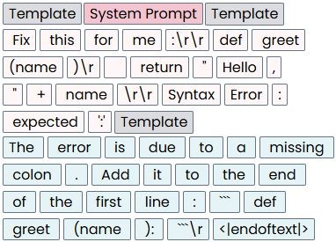
Step 1: Input Tokens
1: Input Tokens
Context Window Size: 40/2048
The tokens in the context window are the model’s only input

Slide 19
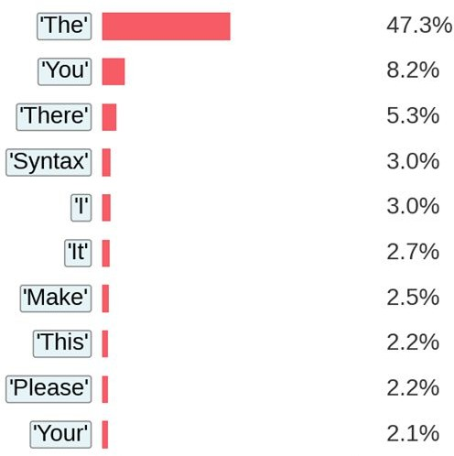
Step 2: Compute Probabilities
1: Input Tokens
2: Compute Probabilities
Context Window
Next token probabilities

Slide 20
Step 3: Select Token
1: Input Tokens
2: Compute Probabilities
3: Select Token
Context Window
Greedy selection
Next token probabilities

Slide 21

Step 3: Select Token
1: Input Tokens
2: Compute Probabilities
3: Select Token
Selected token
Context Window
Next token probabilities

Slide 22
Step 3: Select Token
1: Input Tokens
2: Compute Probabilities
3: Select Token
Selected token
Context Window
Next token probabilities

Slide 23
Repeat
11:: IInnppuutt TTookkeennss
2: Compute Probabilities
3: Select Token
Context Window

Slide 24
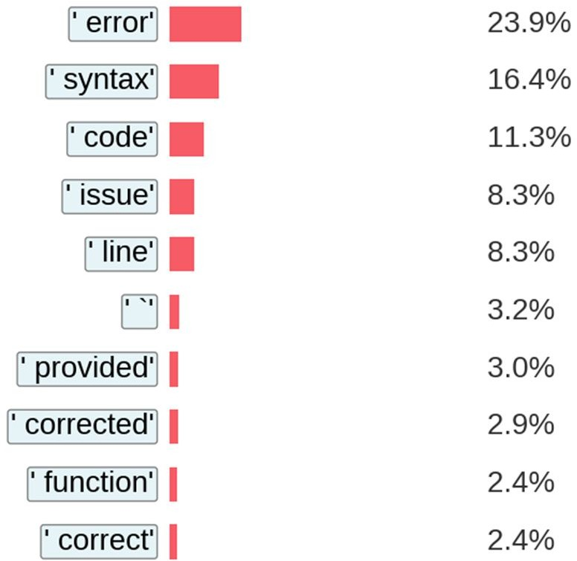
Step 2: Compute Probabilities
1: Input Tokens
2: Compute Probabilities
3: Select Token
Context Window
Next token probabilities

Slide 25

Step 3: Select Token
1: Input Tokens
2: Compute Probabilities
3: Select Token
Context Window
Selected token
Next token probabilities

Slide 26
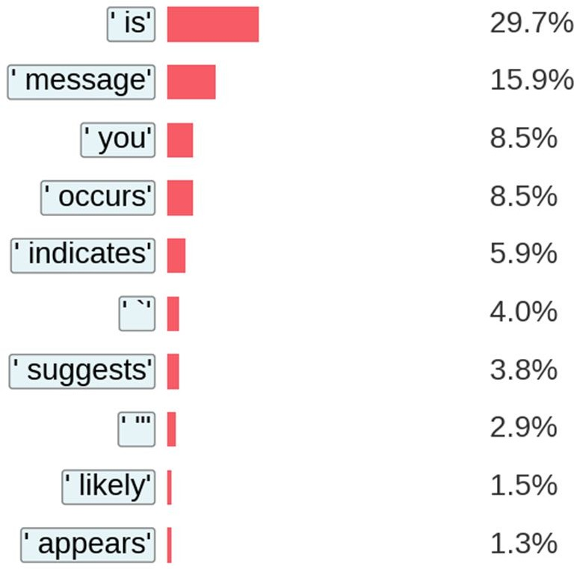
Step 3: Select Token
1: Input Tokens
2: Compute Probabilities
3: Select Token
Context Window
Selected token
Next token probabilities

Slide 27
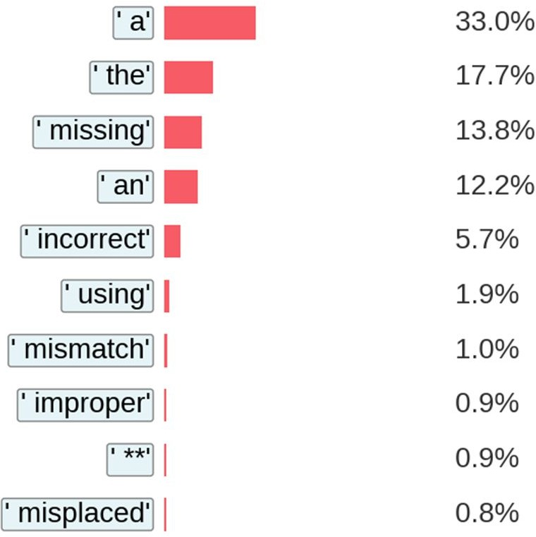


Step 4: Stop or Continue?
1: Input Tokens
2: Compute Probabilities
3: Select Token
4. Stop or continue?
Context Window
?
==
a
<|im_end|>
Next token probabilities

Slide 28
Step 4: Stop or Continue?
1: Input Tokens
2: Compute Probabilities
3: Select Token
4. Stop or continue?
Context Window
a
=x=
<|im_end|>
Next token probabilities

Slide 29
Step 4: Stop or Continue?
1: Input Tokens
2: Compute Probabilities
3: Select Token
4. Stop or continue?
Context Window

Slide 30
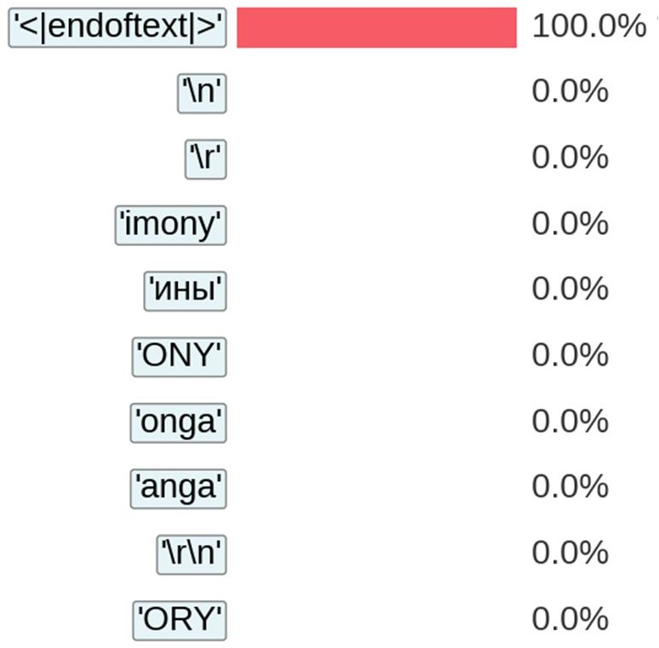
Step 4: Stop or Continue?
1: Input Tokens
2: Compute Probabilities
3: Select Token
4. Stop or continue?
Context Window
<|im_end|>
<|im_end|>

Slide 31
Step 4: Stop or Continue?
1: Input Tokens
2: Compute Probabilities
3: Select Token
4. Stop or continue?
Context Window
<|im_end|>
<|im_end|>
==
Stop!
<|im_end|>

Slide 32
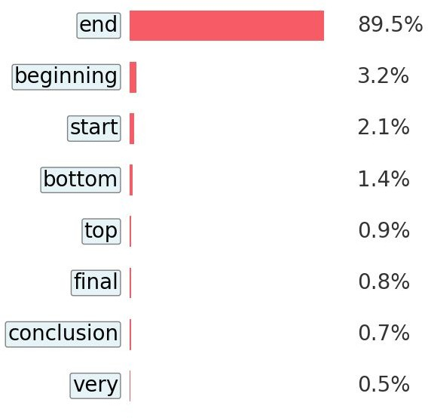
Step 4: Stop or Continue?
1: Input Tokens
2: Compute Probabilities
3: Select Token
4. Stop or continue?
Context Window
Max New Tokens: 14
Output 14
end
Stop!
Output count: 13 tokens

Slide 33
Step 4: Stop or Continue?
1: Input Tokens
2: Compute Probabilities
3: Select Token
4. Stop or continue?
Context Window
Size: 40/41
Max Context: 41 tokens
Total Context: 41
end
Stop!
Max Context: 41 tokens

Slide 34
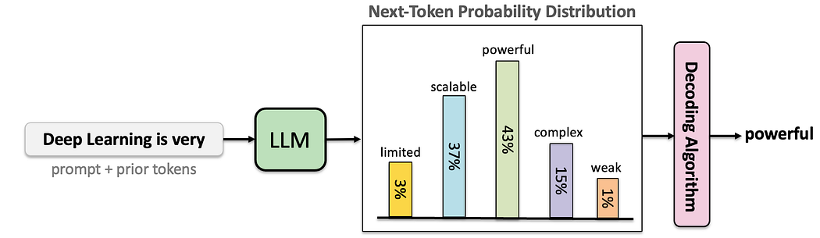
Decoding
Task of choosing a token to generate based on the model’s probabilities
Factors in word sampling: quality and diversity
3 pillars of modern LLM generation
Greedy Search: The baseline for all decoding
Top-P (Nucleus) & Top-K Sampling: The industry standard for open-ended generation and chatbots
Temperature: The universal dial used in every production API today to control creativity
Beam search was the backbone of early machine translation (Seq2Seq), gave way to sampling methods in modern chatbots for diversity, but is now making a strong comeback in AI reasoning agents that need to systematically explore multiple solution paths.
Image credit: https://medium.com/@lmpo/mastering-llms-a-guide-to-decoding-algorithms-c90a48fd167b

Slide 35
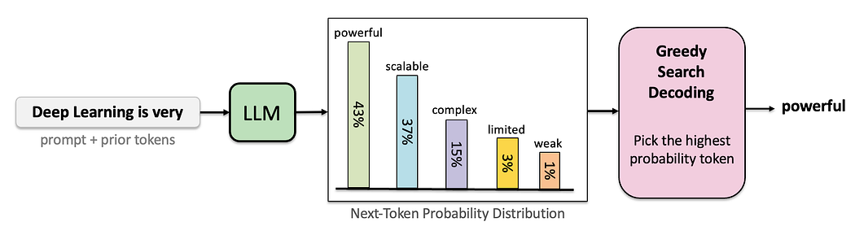

Greedy decoding
Choses the next word to be the most probable word
Selection of the next token is deterministic given the model’s raw predictions
Limitations
Generated text is not necessarily globally optimal
Response may lack creativity, as the model always selects the token with the highest predicted probability without exploring other, less probable but potentially valuable, options
Image credit: https://medium.com/@lmpo/mastering-llms-a-guide-to-decoding-algorithms-c90a48fd167b

Slide 36
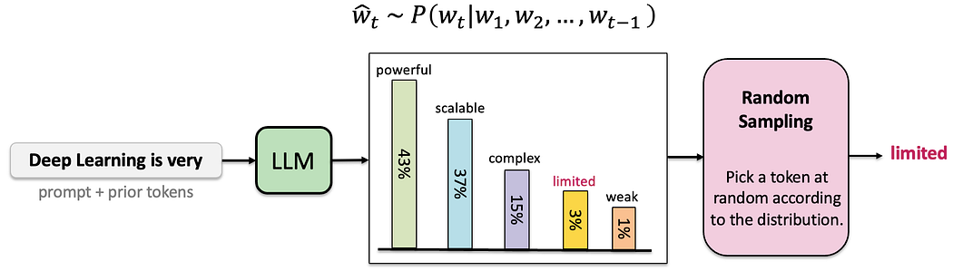
Random sampling
Problem
Many odd, low-probability tokens in the tail of the distribution
They combine constitute a large enough portion of the distribution that they get chosen resulting in generating weird sentences
Image credit: https://medium.com/@lmpo/mastering-llms-a-guide-to-decoding-algorithms-c90a48fd167b

Slide 37
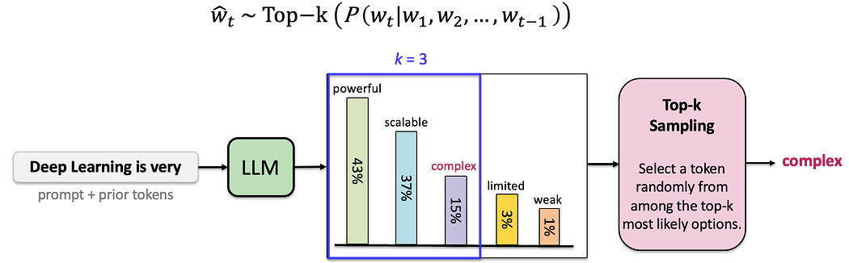
Top K
A small k may limit diversity, while a large k may reintroduce noise
Greedy decoding setting is equivalent to Top K = 1
Unconditioned Tasks: Creative writing, chatbots.
Renormalize scores of the k words to be a legitimate probability distribution
Image credit: https://medium.com/@lmpo/mastering-llms-a-guide-to-decoding-algorithms-c90a48fd167b

Slide 38
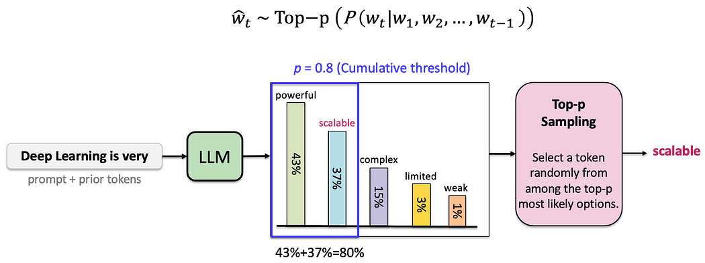
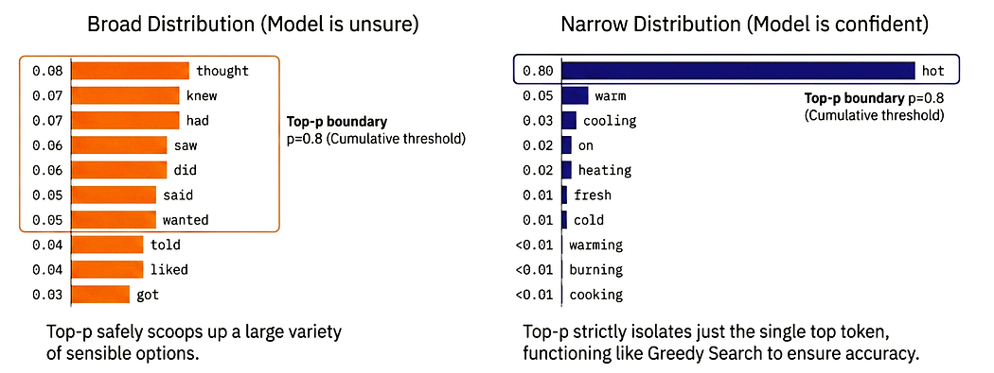
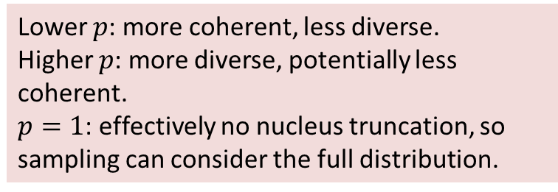
Nucleus or top-p sampling
selecting tokens whose cumulative probability exceeds a threshold p
most popular, balanced method for modern chatbots and creative generation
Top-P is smart enough to be creative when needed and decisive when warranted — all using the same single threshold parameter (e.g., p=0.8)
Lower $p$: more coherent, less diverse.
Higher $p$: more diverse, potentially less coherent.
$p=1$: effectively no nucleus truncation, so sampling can consider the full distribution.
For the same top-p threshold, a flatter distribution keeps more candidate tokens, while a sharper distribution keeps fewer.
Image credit: https://medium.com/@lmpo/mastering-llms-a-guide-to-decoding-algorithms-c90a48fd167b

Slide 39

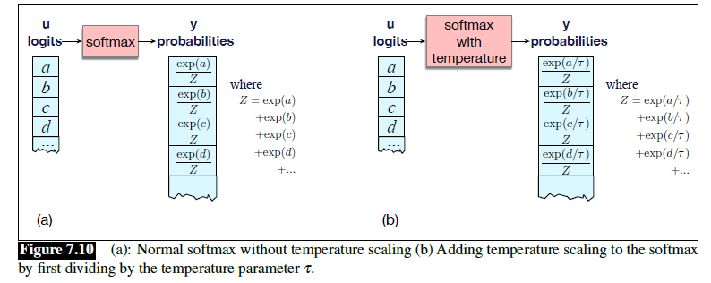
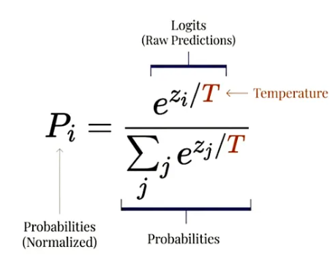
Temperature
A hyperparameter that modifies the probability distribution before applying a decoding strategy.

Slide 40
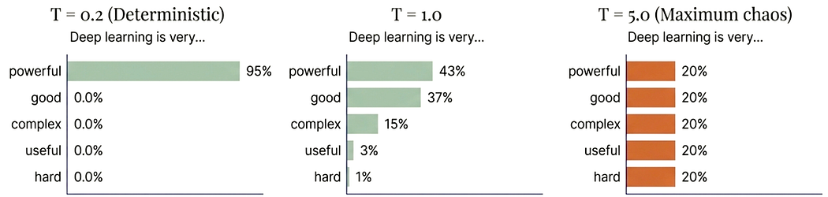
Temperature
Softmax temperature is not a decoding algorithm, which is the way of controlling the diversity via any decoding algorithm
T = 1 → Original distribution is unchanged
If T > 1 →Distribution becomes flatter, increasing randomness and creativity, potentially less coherent outputs
If T < 1 → Distribution becomes sharper, output more deterministic and focused, similar to Greedy Search at low temperatures
Image credit: https://medium.com/@lmpo/mastering-llms-a-guide-to-decoding-algorithms-c90a48fd167b

Slide 41
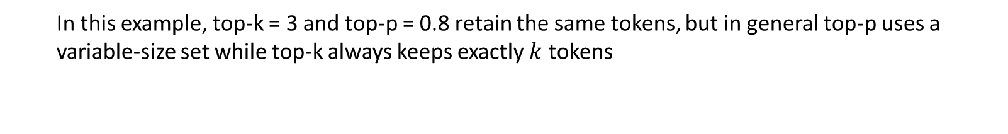
Example - 1
Token | Original probability | Top-k = 3 retained tokens | Top-k normalized probability (Renormalize by dividing with 0.4+0.25+0.17 =0.82) | Top p = 0.8 retained tokens | Top-p=0.8 normalized probability
for | 0.4 | 0.4 | 0.4/0.82= 0.487 | 0.4 | 0.4/0.82= 0.487
to | 0.25 | 0.25 | 0.25/0.82=0.304 | 0.25 | 0.25/0.82=0.304
with | 0.17 | 0.17 | 0.17/0.82 =0.207 | 0.17 | 0.17/0.82 =0.207
and | 0.13
by | 0.05
I took my dog...
for a walk.
to the vet.
with me.
and my cat on vacation.
by the collar.
In this example, top-k = 3 and top-p = 0.8 retain the same tokens, but in general top-p uses a variable-size set while top-k always keeps exactly $k$ tokens

Slide 42
Example - 2
Imagine we give a language model the following prompt, and we're asking it to generate the next word.
Prompt: "The hero opened the chest and found...“ After processing this, the model has calculated the probability for all possible next words
Word | Probability
1. gold | 40%
2. a | 25%
3. treasure | 15%
4. an | 10%
5. nothing | 5%
6. magic | 3%
7. his | 1.5%
8. a dragon | 0.5%
1. Greedy Search
It always picks the single word with the highest probability. No randomness.
It picks gold (40%).
Final Output: "The hero opened the chest and found gold."

Slide 43
Example
3. Top-K Sampling (k=3)
Keeping only the top 3 words, then randomly samples from them.
gold (40%), a (25%), treasure (15%)
Final Output: It might pick gold. It might pick a. It might pick treasure. But it will never pick magic.
4. Top-P (Nucleus) Sampling (p=0.80 or 80%)
Keeps the smallest set of words whose probabilities add up to at least 80%.
Final Output: Randomly chooses from he list is gold, a, treasure (40 + 25 + 15 = 80 %) . It randomly samples from this list.

Slide 44
Example
5. Sampling with High Temperature (T=1.5)
Temperature is a modifier used with Top-K or Top-P. A high T "flattens" the probabilities, making everything more equal
Original Probs: gold (40%), magic (3%)
Logit for gold: 2.5
Logit for magic: -1.1
gold logit: 2.5 / 1 = 2.5 → e^{2.5/1} → Probability = 40%
magic logit: -1.1 / 1 = -1.1 → e^{-1.1/1} → Probability = 3%
T=1.5
gold logit: 2.5 / 1.5 = 1.67
magic logit: -1.1 / 1.5 = -0.73
gold Probability → 20% (It went down from 40%)
magic Probability → 15% (It went up from 3%)

Slide 45
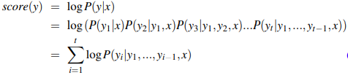
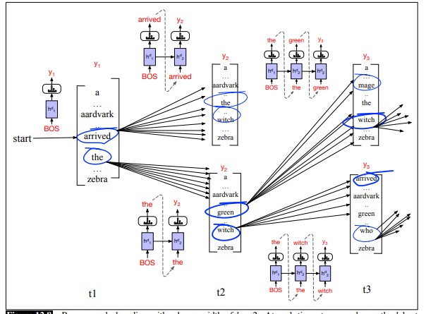
Beam Search
k = 2
Find the most likely complete sentence, not just the most likely next word at each step
At each time step,
K (beam width or beam size) best hypotheses
V possible extensions of each
Softmax is computed over the entire vocabulary at each step
Score k ×V hypotheses
Choose best k = 2 to continue
Beam search builds paths left to right, one token at a time, just like greedy search — but it tracks k candidates simultaneously.

Slide 46
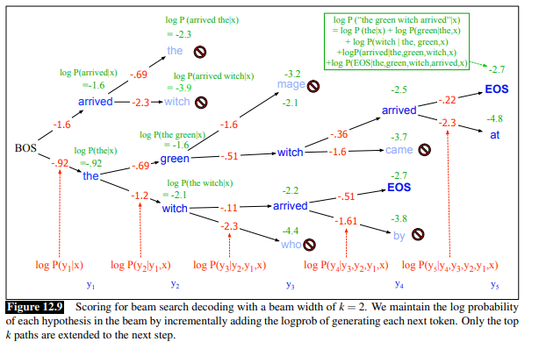

Beam Search
Example:
“The green witch arrived”
Path probability is calculated using
addition of log probability
at each step
“the witch”
Total Score = -0.92 + (-1.2)= -2.12
Lower probabilities to longer strings, a naive algorithm would choose shorter strings for y
Apply length normalization methods, like dividing the log prob by the number of words (Normalize by sequence length)

Slide 47
Example 3
Word candidate | Probability | Full path | Score
"on" | 0.50 | "The cat sat on" | 0.50
"in" | 0.40 | "The cat sat in" | 0.40
"by" | 0.05 | "The cat sat by" | 0.05
"down" | 0.03 | "The cat sat down" | 0.03
Step 1: First word prediction
Model predicts next word after "The cat sat"
K= 2, keep top 2 hypotheses and discard the rest.
Hypothesis 1: "The cat sat on" (Score: 0.5)
Hypothesis 2: "The cat sat in" (Score: 0.4)
score that's the product of probabilities along the path.
Next word | Prob | Full path | New score
"the" | 0.7 | "The cat sat in the" | 0.40 × 0.7 = 0.28
"a" | 0.1 | "The cat sat in a" | 0.40 × 0.1 = 0.04
Step 2: Parallel second word predictions
For each hypothesis, predict the next word independently
Hypothesis 1: "The cat sat on" → What comes next?
Hypothesis 2: "The cat sat in" → What comes next?
K=2, keep the top 2 and discard the rest.
Hypothesis 1: "The cat sat on the" (Score: 0.40)
Hypothesis 2: "The cat sat in the" (Score: 0.28)
(Hypotheses "on a" and "in a" are abandoned forever.)
Next word | Prob | Full path | New score
"the" | 0.8 | "The cat sat on the" | 0.50 × 0.8 = 0.40
"a" | 0.2 | "The cat sat on a" | 0.50 × 0.2 = 0.10
Keep predicting next words for each top-K hypothesis until the model says "stop"

Slide 48
References
Speech and Language Processing (3rd ed. draft) Dan Jurafsky - Ch- 7, 8.6,
https://medium.com/@lmpo/mastering-llms-a-guide-to-decoding-algorithms-c90a48fd167b
Research Papers
Fast Transformer Decoding: One Write-Head is AllYou Need

